Slide 1
Discover J’adore Page
https://www.dior.com/en_int/fragrance/womens-fragrance/discover-jadore-infinissime
Discover J’adore Page
https://www.dior.com/en_int/fragrance/womens-fragrance/discover-jadore-infinissime#liberating-the-golden-jadore-necklace
J’adore Infinissime product page
https://www.dior.com/en_int/products/beauty-Y0996116-jadore-eau-de-parfum-infinissime

Slide 2
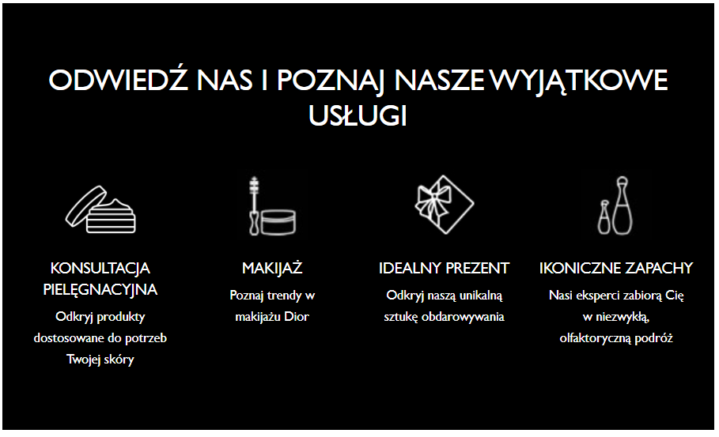
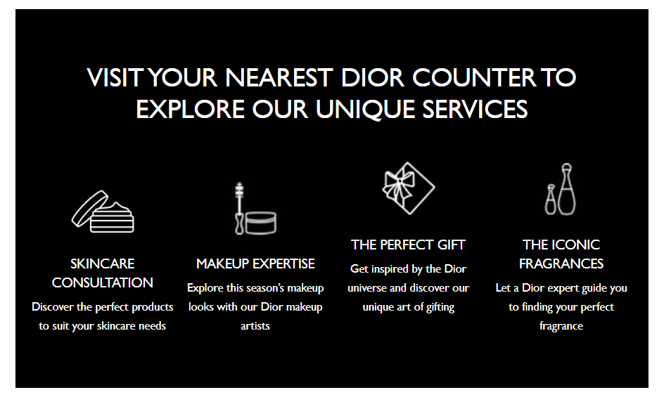
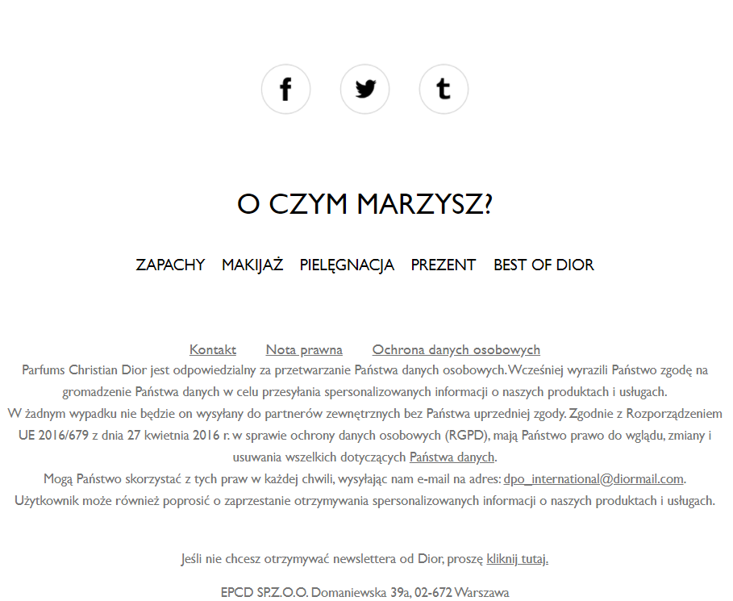
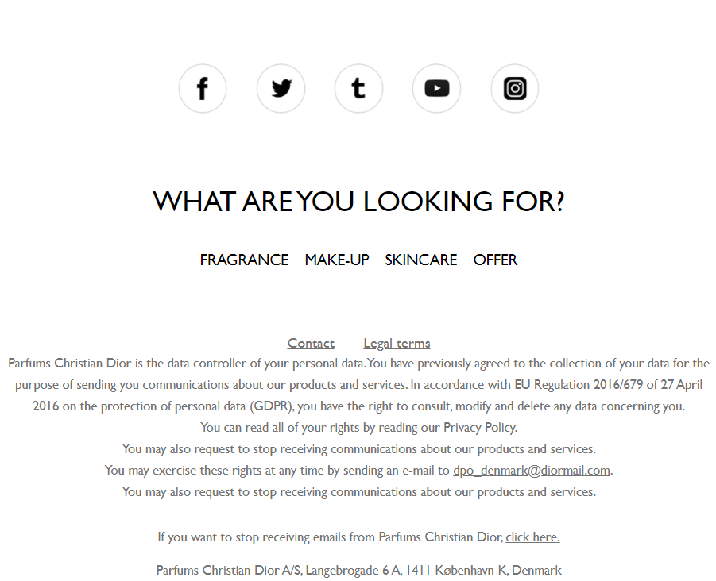
Discover J’adore Page
https://www.dior.com/en_int/fragrance/womens-fragrance/discover-jadore-infinissime#intriguing-grasse-tuberose
Footer
Poland
Footer
Nordics

